Slide 1
C The Programming Language LOOPS
Lecture 10th 12th oct

Slide 2
Repetition/Loop Control
Perform a set of instructions repeatedly
Repetition continues
Counter Controlled(known, definite)
Condition Controlled (Condition true/false)
Types
While statement
For statement
Do-while statement

Slide 3
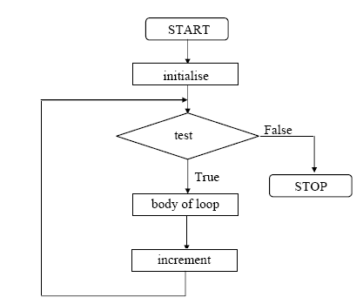
While Repetition Structure
Action repeated while some condition remains true.

Slide 4
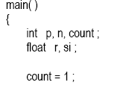
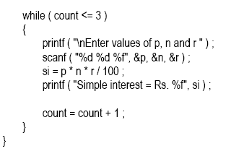
Example: (calculation of simple interest of 3 sets of p,n,and r.)

Slide 5
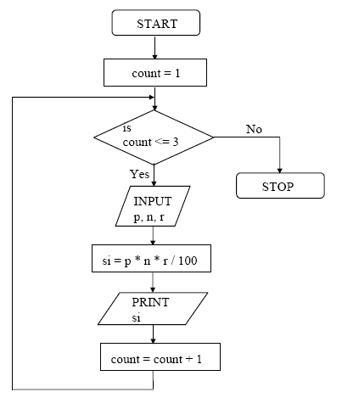

Slide 6
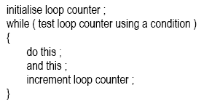
General form of While Loop:

Slide 7

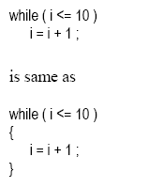
Tips and Traps:
Condition may be any valid expression:
Statements within body may be a single line or block of statements.

Slide 8
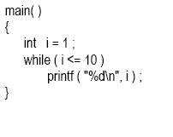
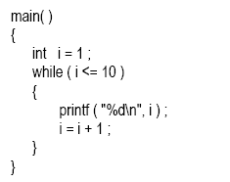
Avoid infinite loops.
The correct form is:

Slide 9
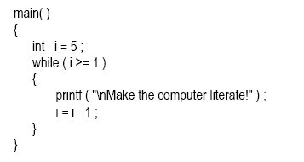
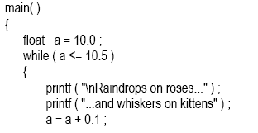

The loop counter can be both incremented or decremented.
Float can also be used as loop counter.

Slide 10
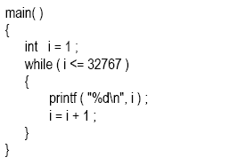
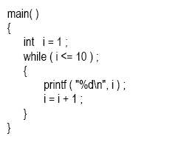
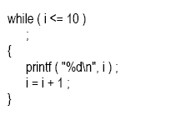
Guess the output:
Again Guess…

Slide 11
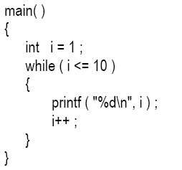
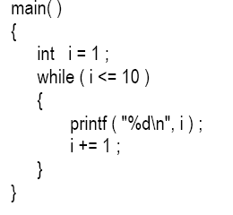
Opertaors:
Increment operator
Pre-Increment: ++i
Post-Increment: i++
Decrement operator
Pre-Decrement: --i
Post-Decrement: i--
Compound assignment operator
i+=1;
i*=2;

Slide 12
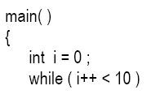

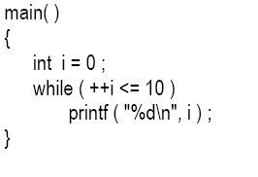
Examples:

Slide 13
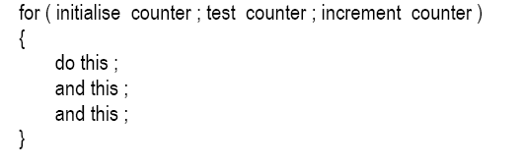
The For Loop:
Most Popular
For Loop requires:
Name of control variable/Loop counter
Initial value of control variable
Condition to test for final value.
Increment/Decrement to modify control variable when looping.
General form of For Loop is:

Slide 14
Example:
main ()
{
int i;
for(i=0;i<=10;i++)
printf(“%d”,i);
}

Slide 15
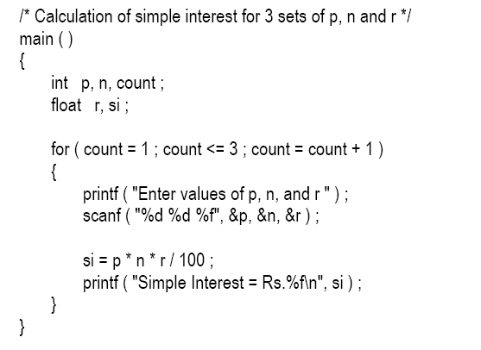
Example 2:

Slide 16
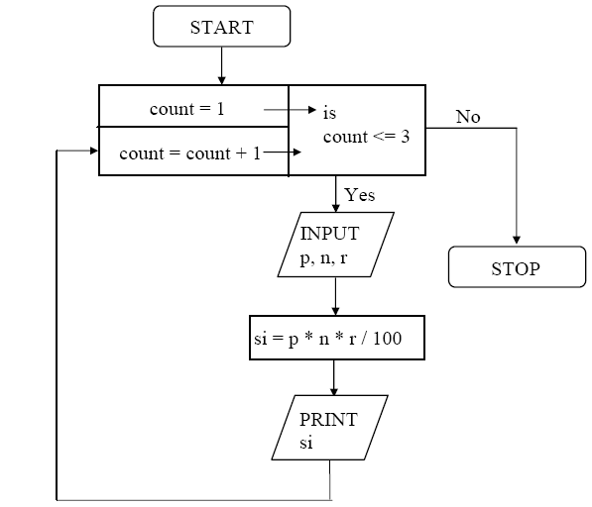

Slide 17
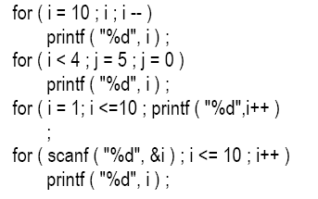
Certain variations:

Slide 18
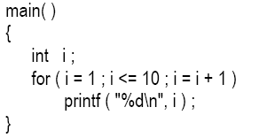
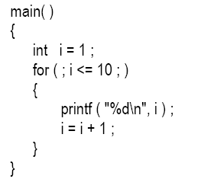
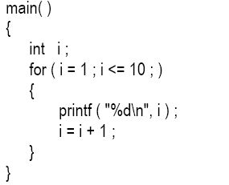
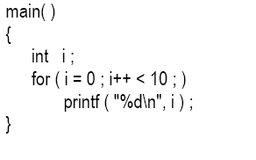
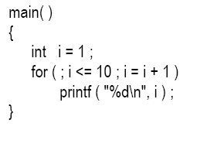
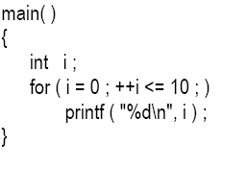
1)
4)
2)
5)
3)
6)

Slide 19
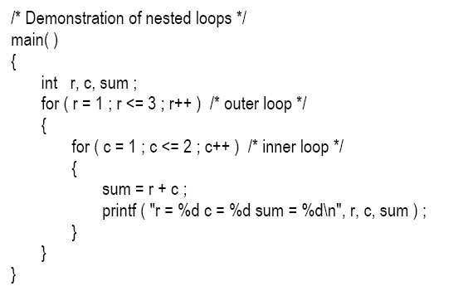
Nesting of For loop:

Slide 20
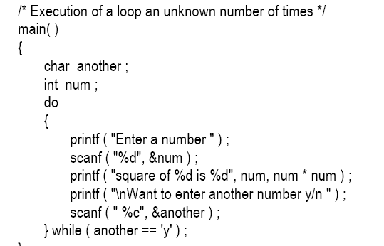
The ODD loop:

Slide 21
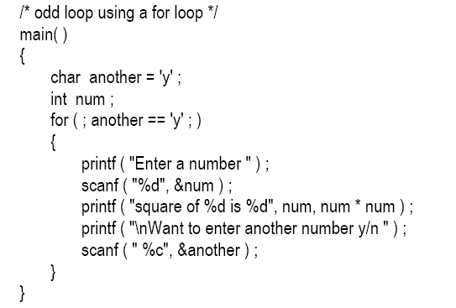
Cobt’d:

Slide 22
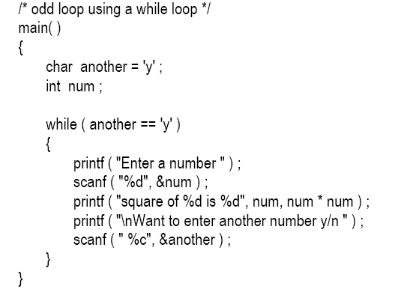
Cont’d:

